Slide 1
Controlling a remote control vehicle using AR principles
Oliver Olding

Slide 2

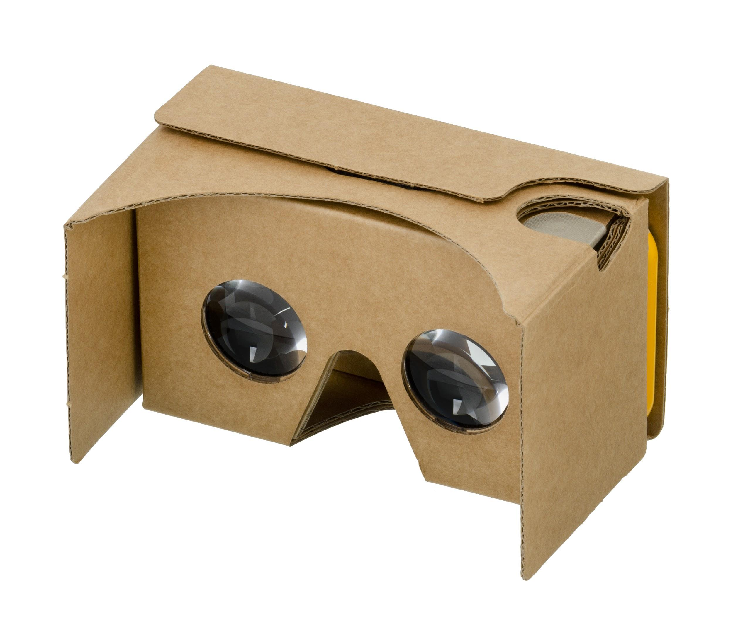
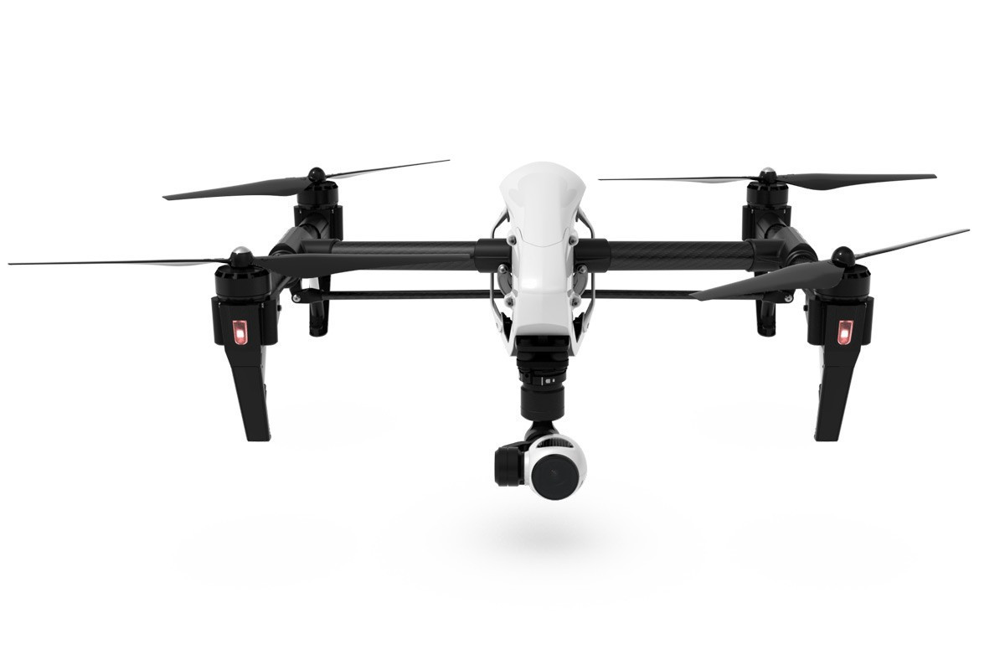

Background
Android phones have all the technology needed to control almost anything
Google cardboard is a cheap and easy way to work with VR or AR
More and more people are using quadcopters for professional filming
Notes:
Technology like wifi, bluetooth, gps, gyro etc.
Cardboard is cheap, mine cost £10, you can make them with less that £5 of material
Quadcopters with cameras range in price, my one costs around £60, but professional ones can cost upwards of £1000, most of them can be controlled with a wifi connection

Slide 3
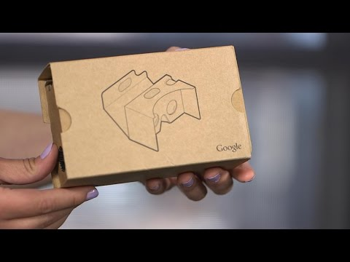
What is Google Cardboard?
It is a device for transforming a mobile phone into a VR headset.
It has two lenses in it so you can focus on the phone screen.
They can be bought online for less than £10
Works with any Android / IOS phone

Slide 4
Idea
Quadcopters that come with a controllable camera are difficult for a single person to fly and get the view they want.
Why not find a way to make it easy and intuitive for people?
We use our head to look around normally, we can look at what we want without thinking about it.
This is what gave me the idea of using AR to control the camera.
Notes:
Explain the difference between VR and AR - AR is adding to reality, VR is creating a new reality

Slide 5
System structure

Slide 6
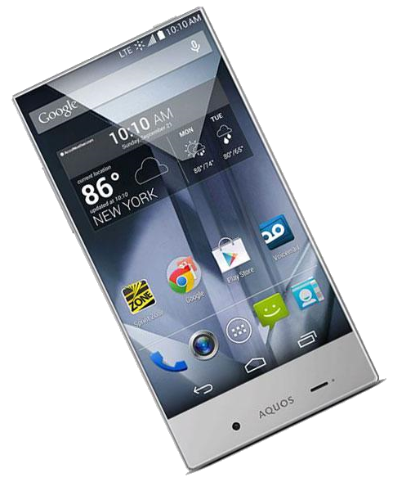
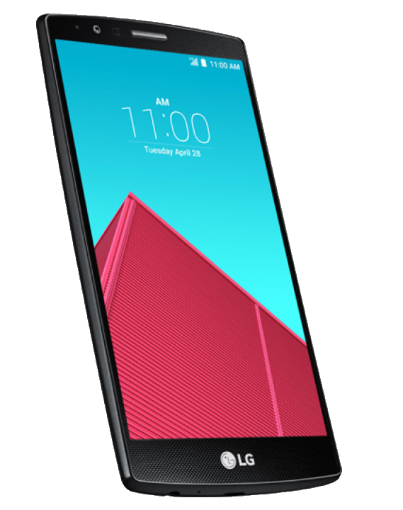
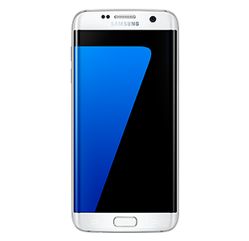
Why use an Android phone?
I could have used a laptop and any VR headset for this, however that is expensive and not very portable.
I chose Android because Android phones are cheap and relatively easy to develop for.
Android also has the benefit of working extremely well with Google Cardboard

Slide 7
Problems
The latency of the video can cause some disorientation and motion sickness.
Having a device covering your face can be dangerous in certain situations.
Different quadcopters use different communications protocols.
They also have different sensitivities, so what may turn one quadcopter half a turn could turn another a whole turn.

Slide 8
Legal stuff
This project is currently in a legal grey area. There aren’t any specific laws regarding quadcopters, however there are some laws for small unmanned aircraft.
These laws were made with larger petrol, nitro and electric helicopters and aeroplanes in mind.
The major rules are that you can’t fly too close to people or buildings without the required permission.
Notes:
No flying within 50m, no take off or landing within 30m of people, stupid because you can fly it inside

Slide 9
Future
I’m going to continue working on this to get a prototype working with my quadcopter.
Then, I’m going to create an API to easily integrate any control mechanism I want.
I also want to add the ability to control more models of quadcopters.

Slide 10
Any Questions?

